Slide 1
Training On Bisiness Emails
By- Harshil J Damani

Slide 2
Email Etiquette
Read the following email.
List three things that you feel this writer does wrong in her email.

Slide 3
Revise this email
To: personidon’tknowwell@ecu.com
From: staffperson@notecu.com
Subject: workshop
IT HAS BEEN A WHILE SINCE YOU SENT YOUR EMAIL ABOUT THE WORKSHOP THAT IS COMING UP. I HAVE BEEN VERY BUSY WITH ALL OF THE EVENTS BY OUR COMPANY. MATCH DAY WAS VERY BUSY FOR OUR OFFICE, AND WE ARE PREPARING FOR SEVERAL MEETINGS THAT ARE COMING UP SOON. DR. DOLITTLE CAN BE SO HELPLESS AT TIMES;) I AM SENDING A POWERPOINT ATTACHMENT. IT SHOULD ANSWER ALL YOUR QUESTIONS. THE WORKSHOP IS DEALING WITH WOMEN IN MEDICINE. HAVE A NICE DAY.

Slide 4
Why is email etiquette important?
Personality of printed word
Reader’s misinterpretation
you are the first impression of your company
The mail can make or break relations
Time saving

Slide 5
Email etiquette - do
Check email promptly
Read each message carefully before you send it
Develop an efficient plan for handling email
Be conscious of what you might be forwarding
Do not alter messages that you are forwarding or reporting
Exercise caution against email viruses
Send short, direct messages

Slide 6
Email etiquette – don’t
Avoid sending confidential information
Do not send messages that provoke a strong emotional response from the receiver
Do not allow email to substitute for personal interaction

Slide 7
Email writing as a summary act
Email requires consideration of the same summary elements as you use in letter writing and phone calling:
Subject
Audience
Purpose
Persona

Slide 8
Write to think
Take three or four minutes to brainstorm the following ideas:
What are some of the typical subjects you address in your business writing?
Who are some of the audiences to which you write on the job?
What are some of the purposes you have for your written communication?
What are some of the voices or personas you have to use while writing in your office?

Slide 9
Consider Your Audience

Slide 10
Consider your audience
You may…
Know your audience personally.
Not know your audience personally.
Need To Write To Foreign Client.
Need to write to more than
one person at a time.

Slide 11
Consider your audience
Put yourself in your reader’s place
If your message does not meet your reader’s needs or if it isn’t written at his or her level of understanding, your message may be ignored.
If unknowingly the tone of the mail is rough or harsh, the reader may react in an un wanted manner.
The message remains un said and scope of miscommunication is more.

Slide 12
When you know your reader
How interested or involved in the subject is my reader?
How knowledgeable is he or she about the subject?
What is my reader’s purpose for reading? To make a decision? To be better informed?
Will my reader understand the language used in the mail?
How much time will my reader give to my mail?

Slide 13
When you know your reader
Does my reader have special concerns or strong views about the subject? What are they?
How does my reader regard me personally and professionally?
What is my reader’s style of doing business?
What is the tone preferred by the reader?

Slide 14
When you do not know your reader
There are two general types of business readers: skimmers and skeptics.
Your documents will be most effective if you write for both types of readers.

Slide 15
When you do not know your reader
Skimmers are readers that are typically very busy. Pressed for time, they often skim documents in a rather short period of time.
A Skeptic is a reader that is cautious and doubtful.
Skeptical readers will tend to read a document carefully, questioning its validity and the writer’s claims.

Slide 16
20-second test for Skimmers:
Skim your document for 20 seconds, and mark what stands out most to you in that amount of time.
After you are finished, see if what you have marked is able to convey your message clearly.
If it is possible (or an important document), have someone else skim your document before sending it, and see if your message is clear to them as well.

Slide 17
Skeptical readers
Skeptical reader - support your statements with sufficient details and evidence
Provide specific examples
Numbers if any
Dates if any
Names if any
Percentages if any

Slide 18
Consider your purpose
Business writing is convincing writing.
Some business writing will try to convince the reader to take an action or think about something in a certain way.
Is it just to pass a message.
Is it wanting any suggestions/ solutions to any problem.
Is it a feedback.
Is it a customer problem to be solved.

Slide 19
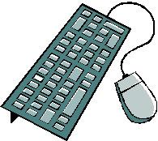
Email writing as a process

Slide 20
Drafting an email
Use the recipient’s name
If you do not know the person personally, a generic greeting is appropriate
If you do not know the recipient personally, identify yourself early in the message

Slide 21
Content and organization
Your document will be most successful if it matches the reader’s expectations.
Three common expectations:
Get to the point
Be as simple as possible
Use passive and active voice appropriately

Slide 22
Content
Your Goal should be to include enough information to keep the reader’s interest but not so much information that you waste the reader’s time and deviate from your main point.
you should focus on communicating your primary message successfully.
The intention should of deriving a positive response to your email most of the times.

Slide 23
Organization
What is the best order for the sentences in this problem-solution email? Place a one beside the first sentence, two beside the second…
Would Dr. Spock be willing to reschedule the meeting Monday for Wednesday, April 15 instead?
Dr. Suess currently has a meeting scheduled with Dr. Spock on Monday, April 13.
Dr. Suess greatly appreciates your patience and flexibility.
Dr. Suess will not be able to attend this meeting due to an out of town appointment.

Slide 24
Organization
Short communications - inverted pyramid
Longer communications - state purpose early

Slide 25
Writing the message
Be concise.
Be clear.
Always proofread.
Understand that some emails will never go away and that some readers will judge you on the basis of what you have written.

Slide 26
Short communication: The inverted triangle
Present your conclusions or major idea first, followed by the reasons or support.
Example:
Dr. Suess would like to reschedule the meeting he has scheduled with Dr. Spock. He is proposing that they now meet on Wednesday, April 15. While the original meeting was planned for Monday, April 13, Dr. Suess has an out of town appointment on that day. We appreciate your patience and flexibility.

Slide 27
Longer messages
Use an “elevator” summary at the start of the email so that the organization will be easy to follow.
Example: “We have had difficulty getting grades posted in a timely manner. Therefore, I am suggesting that…”
Present your reasons first and your conclusions after.

Slide 28
Longer messages
Even when using this plan, be sure to state your main point up front.
Example: You did such a good job of explaining the merits of our new Tuition Assistance Program that I have tentatively decided to apply for the program myself. To keep my options open, then, I must ask you to select someone else to serve on the
program committee. . .
If you require a response from your reader, make sure you ask for one at the start of your email.

Slide 29
Longer communications
One idea per paragraph.
Table of contents or headings.
Pointers and important content to be highlighted.
Use bullets wisely to help reading better.
Hard copy availability.

Slide 30
Tone
Be friendly.
Avoid negative words, especially those that begin with “un, non, ex” or that end with “less”.
Use contractions to add a friendly, conversational tone. (don’t, won’t, can’t)
Situation + Audience = Tone

Slide 31
Bad news emails
Give the news first
Avoid assigning blame
Avoid uncertainty
Offer a positive resolution at the email’s conclusion

Slide 32
Emailing a complaint
Give the context, the history of the problem
Give the history of your efforts to solve the problem
Tell the reader why he or she is involved and what he or she needs to do to help solve the problem
Offer suggestions as to how the problem might be solved

Slide 33

Flaming
“Flaming is a virtual term for venting or sending inflammatory messages in email.”
--Purdue owl
Flaming tends to create conflict
Flaming makes long-term enemies
What you write in an email cannot be taken back!

Slide 34
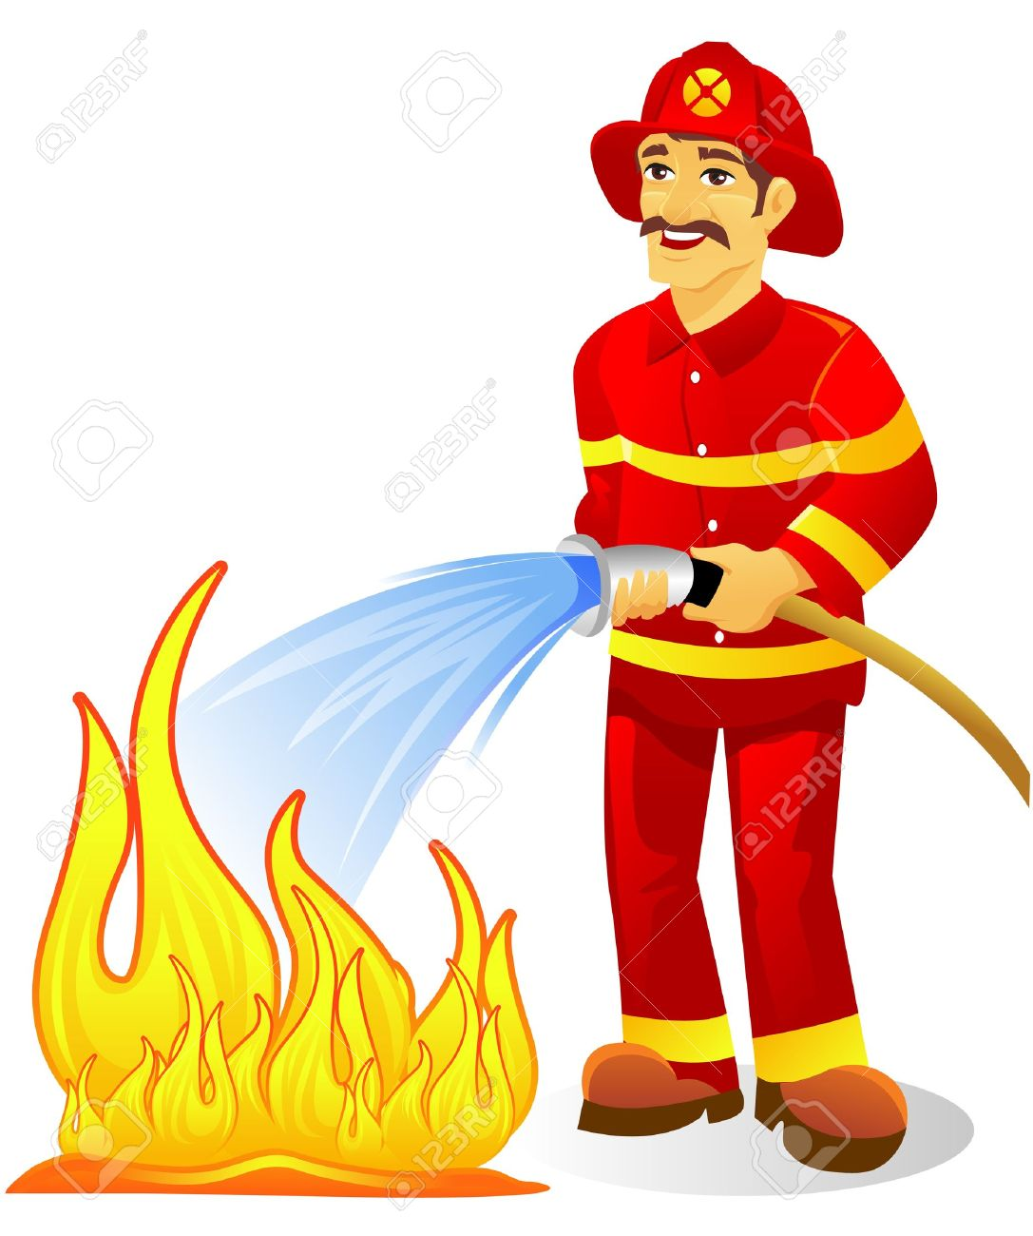
Controlling flaming
Ask yourself: “Would I say this to the person’s face?”
Calm down before responding to an email that has irritated you.
Read your email twice before sending it.
Assume your email will be misunderstood and that the intent with which you wrote it will not be assigned to it.

Slide 35

Responding to a flame
Empathize with the reader and avoid engaging in a dispute
Thank the reader for bringing the matter to your attention
Explain what circumstances led to the problem, as you understand it
If you are aware that the situation is in the process of being resolved, let the reader know in the first sentence or two
Apologize if necessary

Slide 36
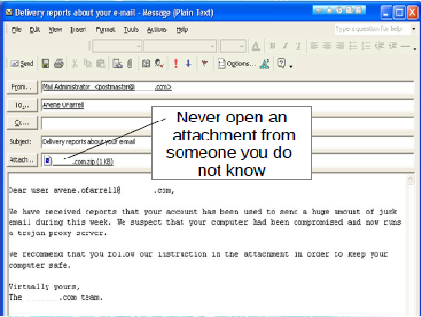
Handling Attachments
Other files sent with the message.
Scan the attachment before opening.
Rout the attachment through the EDP department in case of any doubt.
Incase of important attachment save it to the

Slide 37

General email tips

Slide 38
General guidelines
Include appropriate salutation and closing.
Make excellent use of the subject line.
Limit each message (or paragraph) to one idea.
Present information in the order in which it is likely to be needed (e.g., give the nature and purpose of an upcoming meeting before giving the date, place, and time).

Slide 39
General guidelines
Explain and identify attachments
Use jargon(slang, lingo, terminologies) when appropriate
Proofread carefully
Use emoticons (Smiles) and abbreviations in moderation
Beware of caps lock

Slide 40
Revise this email
To: personidon’tknowwell@ecu.com
From: staffperson@notecu.com
Subject: workshop
IT HAS BEEN A WHILE SINCE YOU SENT YOUR EMAIL ABOUT THE WORKSHOP THAT IS COMING UP. I HAVE BEEN VERY BUSY WITH ALL OF THE EVENTS BY OUR COMPANY. MATCH DAY WAS VERY BUSY FOR OUR OFFICE, AND WE ARE PREPARING FOR SEVERAL MEETINGS THAT ARE COMING UP SOON. DR. DOLITTLE CAN BE SO HELPLESS AT TIMES;) I AM SENDING A POWERPOINT ATTACHMENT. IT SHOULD ANSWER ALL YOUR QUESTIONS. THE WORKSHOP IS DEALING WITH WOMEN IN MEDICINE. HAVE A NICE DAY.

Slide 41
Phone Etiquette
When Your Call is Answered
Speak slowly and clearly.
Introduce yourself and place yourself in context, i.e., ―Hi, my name is Terry Pilgrim and I am calling as a prospective candidate for the profile offered by your company.
Ask for who you wish to speak with directly, i.e., ―May I speak with Carol Johnson in HR department?
If your call has to be transferred, thank the answerer for her/his assistance.

Slide 42
Continued….
Leaving a Message :
Speak slowly and clearly.
Include your name, phone number, and the reason you are calling.
Repeat your name and phone number. For example: ―My name is Jill Crane and I am calling to speak with you about the social work position that is open in your department. My number is 617-555-1212; that’s 617-555-1212 and my name is Jill Crane.

Slide 43
Continued….
Cell Phone Use :
When you are interacting with others, whether it is in a meeting or during a meal or conversation, turn your cell phone to silent or vibrate.
Allow non-emergency phone calls go to voicemail.
If you are expecting an emergency call that truly cannot wait until after your present activity, let those with whom you are meeting know that you might receive an emergency call, and politely excuse yourself to take or return the call.
Do not speak on your cell phone while you are interacting with other people.

Slide 44
Continued….
Remember that your telephone conversation in public settings may not only be disruptive to others, but bystanders can also hear your side of the conversation.
When using the telephone in any public setting do not discuss professional business such as your company or organization's plans, projects or deals, or share comments about your colleagues in public settings such as elevators, restaurants, sidewalks or public transportation.
If you have to conduct business on the telephone while you are away from your office, move away from others to a private location to ensure that your conversation maintains confidentiality.

Slide 45


